Slide 1
Evidence Journal Project 3: Breaking Horizons
Summative
AAD531 Front-end Web Design
Name: Prapti Ankush Mane
Student ID: 13491449
Date: 18/06/2021

Slide 2
Complete the following pages
Make the Evidence Journal your own, add and change fonts, add extra pages!
Note: Delete all instructional pages and text from this template before you submit!

Slide 3
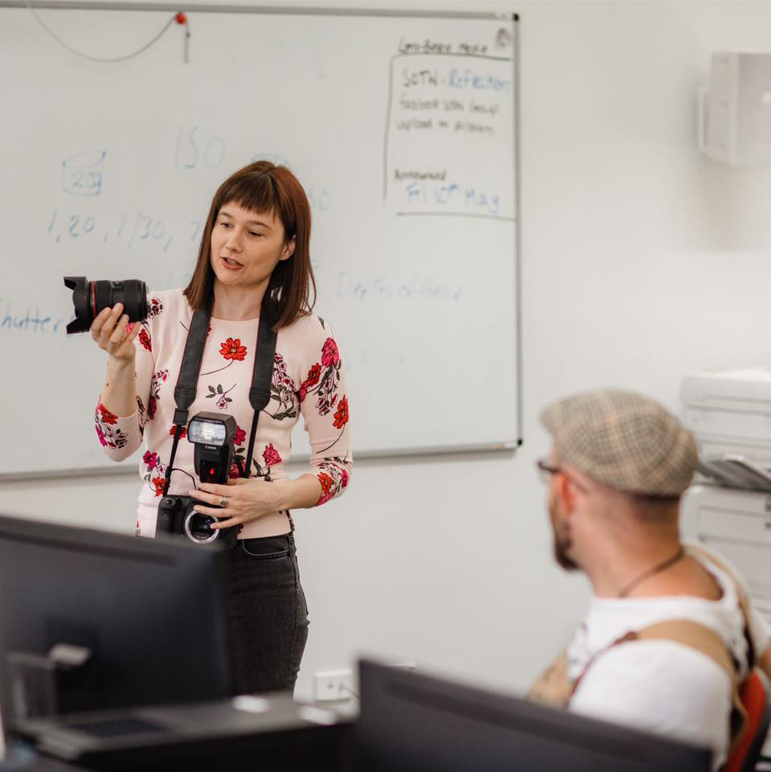
Referencing
It is important you reference any material which is not your own. This includes images, quotes and information. Refer to the Resources section for referencing guide, exemplars and further information.
Tip: When you reference an image use 8pt font like this
Reference any images that are not your own in numerical order throughout your Evidence Journal. Then at the end include an appendix with the slide name and refence information. See the end of this template for an example.
Fig. 1

Slide 4
Annotations
Include annotations as you go along. What are annotations? They are brief notes documenting your thoughts and process. They can include camera data and information on how you created your image. Think of your Evidence Journal a bit like a diary or notebook, it gives you a chance to express yourself and your journey.

Slide 5
How to annotate your work
Include information, such as
the title of the image, artist's name and details or when it was created
a record of your experiences and emotions connected to an image
a record of how you intend to use these images to develop your own ideas
an example of your progress through a project
To annotate your work successfully, you should explain:
what you have done? and why you did it?
how you did it? such as the media and techniques used
why you chose a particular medium or technique
how the artwork fits in with your project?
what aspects you like and why?
how you could improve the work?
what you think you will do next?

Slide 6
How to annotate your work
Use the correct vocabulary when annotating your work to show that you are developing your knowledge, understanding and skills.
Visual language terms
Subject - what is shown in the artwork, such as a portrait or a still life
Composition - how the elements of the work are arranged, i.e. whether they're close together or far apart
Foreground and Background - elements that appear to be in front of or behind other aspects of the artwork
Line - can vary in width, length, curvature, colour or direction
Shape - describes the two-dimensional outline
Form - describes a three-dimensional object
Texture - the way surfaces look and feel, i.e. grain, sharp, blur, etc.
Tone - shading, from dark to light

Slide 7
What is an Evaluation
An evaluation is a piece of writing where you look at your project as a whole and discuss its successes and weaknesses. This can help others understand what you were trying to achieve. You need to be honest and use the appropriate art language.
When you're evaluating your preparatory work, you should consider:
What was the theme for the project?
How have you developed your ideas?
How did your work change through the project?
How much reference material did you find?
What artists, art movements or cultures have you looked at to help and inspire you?
What materials, tools and techniques did these artists use?
How have your skills developed during the project?
Are there any aspects of your studies that you wish you had explored further?
You also need to evaluate your final piece:
You should reference relevant work from your preparatory studies
How have you used formal elements such as line, tone, colour and shape?
What materials did you use, and why? Did they work successfully?
What meaning and messages did you want to convey and were you successful?
Are you happy with your final piece? Are there any elements you like in particular?
Is there anything you would change? Why?

Slide 8

What is an Evaluation
All evaluations are structured and performed in the same way, so you may also find this helpful for future reference.
Note: To play this video click on SlideShow>From Current Slide

Slide 9
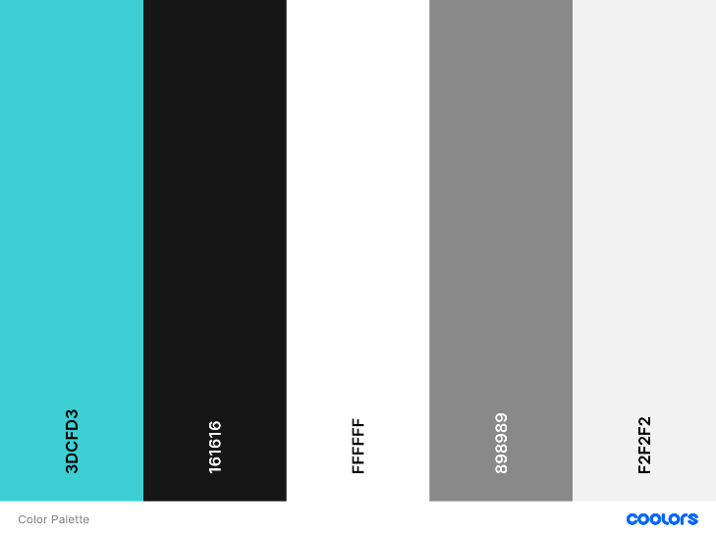
Colour choices
The reason for these colors were approved by the client. She has always used this color even for her visiting cards hence the colors were established by the client. The reason she told me behind these colors is that it is gender neutral. Since my client caters to men, women and children these colors seem ideal choice. The buttons have the border of the turquoise where they’re on a black background as it really helps the button stand out and when you hover over them the background of the button turn completely turquoise. The text on the buttons is in white which is standard throughout the website as somewhere the buttons are on a black background, and you won’t be able to read black text. I have used span on my headers so the text could be colored accordingly. The social media icons have a turquoise hover. Services grid boxes also have a turquoise hover. Since the send message button is on a white background the button is turquoise and the text inside the button is in black, and the hover for that button is white.
I used https://coolors.co/ to generate the color palette.

Slide 10
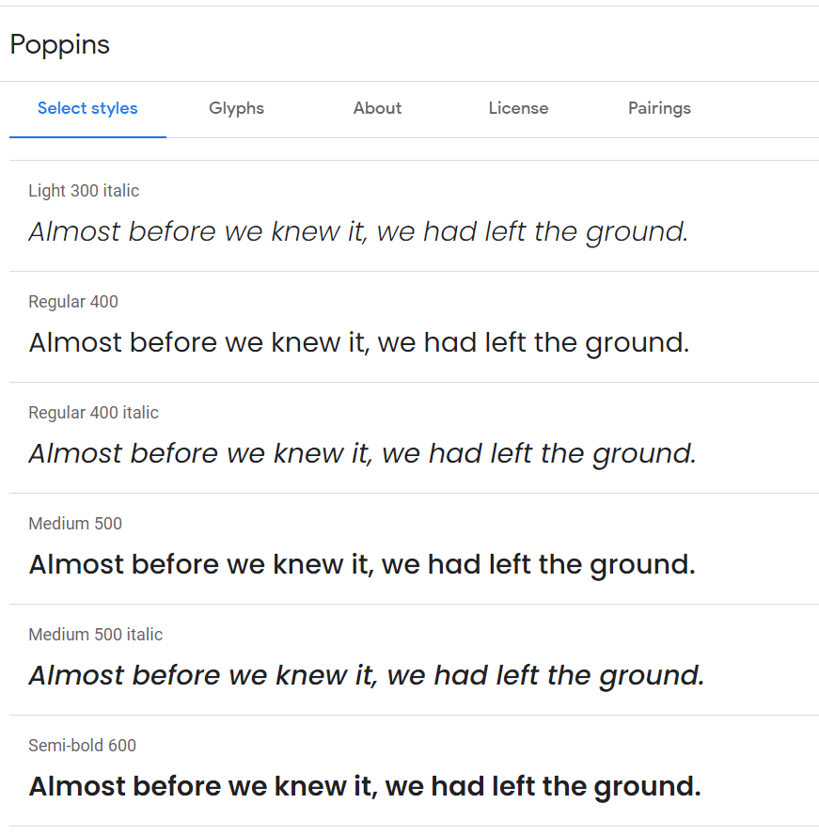
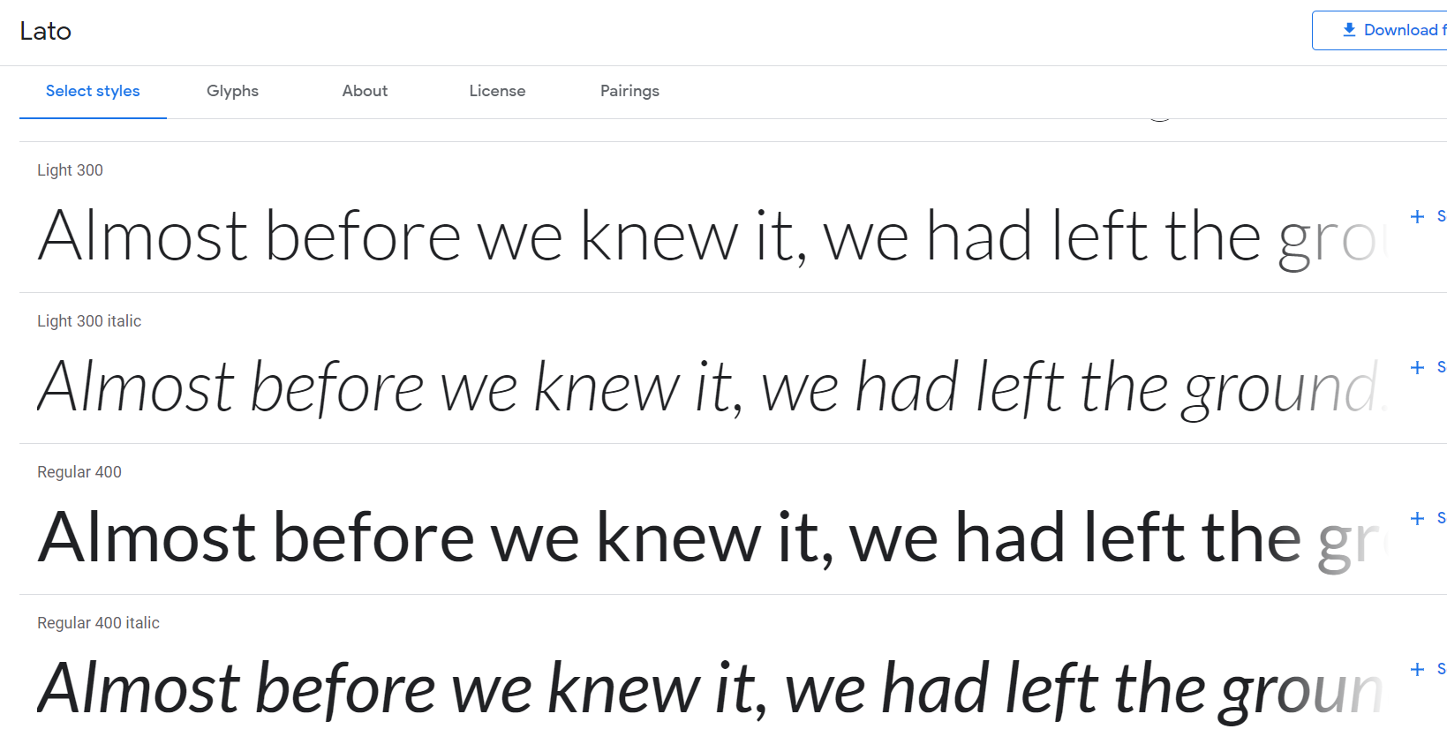
Font choices
I have used Google font to download my choices of fonts. I have used two times of fonts, Poppins and Lato. The body of the website is written in Poppins, and the fall over font is sans-serif incase Poppins doesn’t work. The about me section, the paragraph section for services, the text on the cards, the book an appointment paragraph all uses the Lato fonts. The reason I chose these fonts is because I thought they go well with the colors of the website, and it feels gender neutral just like the brand.

Slide 11









SVG choices
Kayla Jolly only has Facebook and Instagram for her brand at this stage, but she will be making a Linkedin profile soon, hence I have also added a linked plugin. The plugins are under the about me section after the paragraph finishes.
I have used https://www.flaticon.com/ to download the icons.

Slide 12
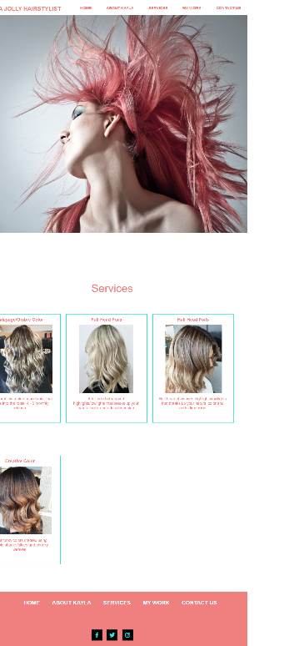
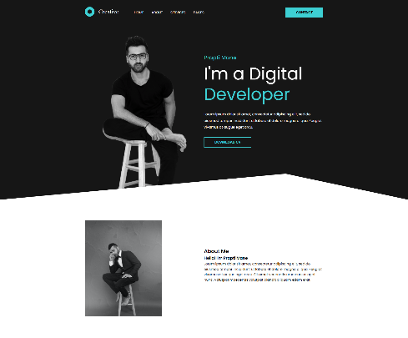
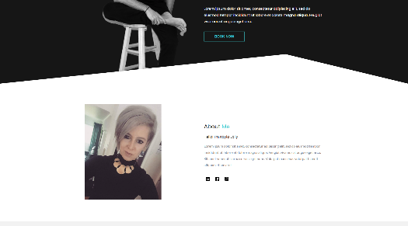
Evolving design
The design of the website is a mixture of what we had 2 years ago, I mixed it up with the new portfolio design that I found online.
This is the link of the tutorial that helped me build this website.
https://www.youtube.com/watch?v=8r1MHZec4Hc
I have changed the design slightly, but not too much cause it was perfect with what my client is looking for, hence I have changed a few things.
On the left you can see the screenshots of the evolving stage of the design. The logo for the website was created using Canva. Couple of years ago Kayla Jolly didn’t want a logo but this time she decided she want a logo for the website hence I used Canva to create the logo.
As you can see 2 years ago we were using Turquoise and Pink but we have realized the previous design was extra pink which promoted that it’s a feminine brand but now Kayla has also started barbering side of things which is gender neutral hence the pink is not needed anymore.
In the final design we have changed the Banner image this image will be changed again once Kayla gets a photoshoot done, as well as the about me image
As far as the CSS is concerned I have created

Slide 13
Inspiration
Here you will need to include a screenshot of the design/ designs that you found influential, this can be by an individual designer or many or even a design studio. Make sure you reference the sources and names appropriate.

Slide 14
UXD Analysis
Here, you will need to describe and analyse the User Experience Design of a chosen single page website. Describe what elements have emphasis over others and why, what colour schemes are used, what images, photography and why. Choose a design which influences/ inspires you and your design. Analyse what it is about this website design that functions well, such as the animation of elements, changes in colour and images. What are the important interactions? Make sure you include who created the design and cite anyone who you quote using the APA referencing format (use: http://www.citefast.com). Your analysis must be at least 500 words. Include screenshots of the single page website in every instance. You can choose more than one to analyse if you wish.

Slide 15
Professional practices and standards
This is where you’ll identify and summarise one professional website design practice or standard.
For example, choose one of your own or one of the following topics that you have not investigated before to summarise relating to professional practices or standards of website design:
Designers responsibilities
Effective communication for a designer
Copy right
Customer service
Approx. 200 words

Slide 16
Your final design
Here you will need to write a short ‘final evaluation’ on your progress throughout this project. Try to be reflective as much as possible, talk about the successes’ and troubles you may have overcome, explain the reasons behind your final design and what you would improve if you had the chance to do so.
LINK to your website HERE
You must ensure you have provided a link to your website here.

Slide 17
Your final design
Here you will share large screen shots of your final website, use as many pages as you like and make sure to share screen shots of all aspects of your website.

Slide 18
Appendix
Slide 3 - Jessica Shirley 2019, www.jessicashirley.nz

Slide 19
Bibliography
This is where you list any quotes or citations you have used. List them in alphabetical order.
For example:
BBC online, https://www.bbc.com/future/article/20180104-is-social-media-bad-for-you-the-evidence-and-the-unknowns, accessed 11/05/2020.
Forbes, https://www.forbes.com/sites/alicegwalton/2017/06/30/a-run-down-of-social-medias-effects-on-our-mental-health/#3f76e932e5af, accessed 11/05/2020.

Slide 20
Submission
Remove instructional text
Check for errors in spelling or grammar
Format your writing and images, so they are clear and easy to read.
Check your referencing – include an appendix and bibliography
Check the assessment brief to ensure you have completed all of the requirements and learning outcomes.
Name your document correctly For example AAD531JessShirleySummative.pptx

